Slide 1
Microprocessor and Computer Architecture(ELX 301)
BIT 3rd Semester
Er. Suraj Basant Tulachan
Assistant Professor

Slide 2
Unit 7: Input & Output Organization
Outline:
  7.1 Introduction to Peripheral Devices
  7.2 Input-Output Interface
  7.3 Direct Memory Access
  7.4 Input-Output Processor
  7.5 Data Communication Processor

Slide 3
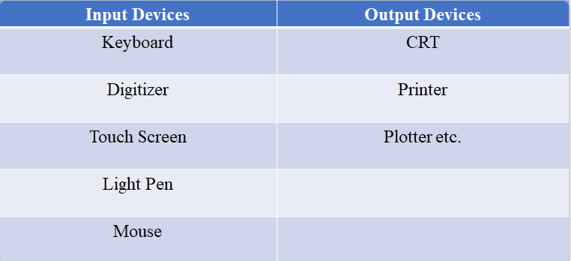
Unit 7: Input & Output Organization
Introduction to Peripheral Devices:-
Devices connected to computer are called peripheral devices. E.g. keyboard, mouse,printer, magnetic tape, magnetic disk etc.
Input output operations are accomplished through peripheral device that provides a means of exchanging data between the external environment and the computer.

Slide 4
Unit 7: Input & Output Organization
Input-Output Interface:-
There are several problems while we are trying to connect the peripheral devices directly with the CPU.
They are:
i. There are wide variety of peripherals with various methods of
operation.
ii. It would be impractical to incorporate the necessary logic within the
processor to control a range of devices.

Slide 5
Unit 7: Input & Output Organization
Input-Output Interface:-
iii. The data transfer rate of peripherals is often much slower than that of
the memory and processor.
iv. Thus, it is impractical to use the high speed system bus to communicate directly
with a peripheral.
v. Peripheral devices often use different data formats and word lengths than the
computer to which they are attached.
vi. Peripherals are electromechanical and electromagnetic devices and their manner
of operation is different from the operation of CPU and memory, which are
electronic devices.
vii. Therefore, a conversion of signal values may be required.

Slide 6
Unit 7: Input & Output Organization
Input-Output Interface:-
We cannot connect peripheral directly with CPU, we need I/O interface.
The main functions of input-output interface circuit are data conversion, synchronization and device selection.
Data conversion refers to conversion between digital and analog signals, and conversion between serial and parallel data formats.
Synchronization refers to matching of operating speeds of CPU and other peripherals.
Device selection refers to the selection of I/O device by CPU in a queue manner.

Slide 7
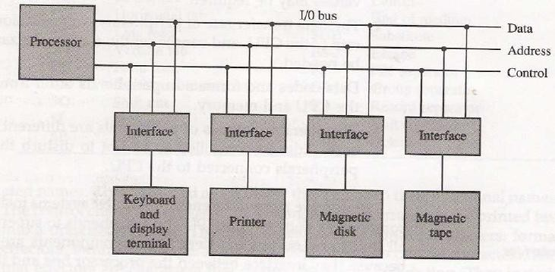
Unit 7: Input & Output Organization
Input-Output Interface:-

Slide 8
Unit 7: Input & Output Organization
Input-Output Interface:-
Above figure shows the I/O bus and I/O device connected with interface unit.
Each interface attached to I/O bus contains address decoder that monitors the address line.
To communicate with a particular device, the processor places a device address on the address lines.

Slide 9
Unit 7: Input & Output Organization
Input-Output Interface:-
When the interface detects its own address, then it activates the path between the bus lines and the device that it controls.
All the peripherals whose addresses don’t correspond to the address in the address bus are disabled by their interface.
At the same time, the address is made available in the address line; the processor provides a function code in the control line which is also called I/O command.
The interface selected responds to the function code and proceeds to execute it.

Slide 10
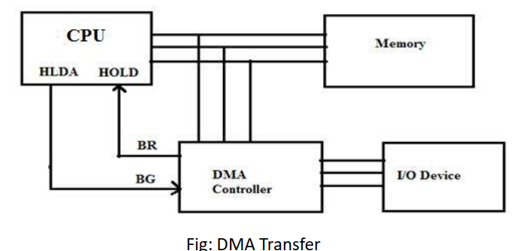
Unit 7: Input & Output Organization
Direct Memory Access:-

Slide 11
Unit 7: Input & Output Organization
Direct Memory Access:-
Large amount of data can be transferred between memory and peripheral, severely impacting CPU performance.
The processor is tied up in managing an I/O transfer; a number of instructions must be executed for each I/O transfer limiting its speed.
To overcome limitations, DMA is used to transfer the data between memory and I/O device with less involvement of CPU.
In this transfer mode, DMA controller sends Bus Request (BR) to CPU enabling BR line.
After receiving BR request, CPU acknowledges the DMA controller by sending Read/Write control signal, Device address, Starting address of memory block for data and amount of data to be transferred.

Slide 12
Unit 7: Input & Output Organization
Direct Memory Access:-
It disables control over system bus by issuing Bus Grant (BG) signal to DMA controller.
CPU does other works.
DMA controller then start transfer of data between memory and I/O.
After completing all transfer of data, the controller sends interrupt to CPU informing that it has completed the job assigned to it.
The CPU finalizes the DMA operation and resumes it operation.

Slide 13
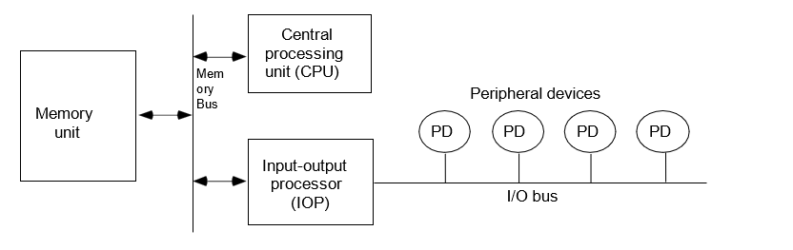
Unit 7: Input & Output Organization
Input-Output Processor:-

Slide 14
Unit 7: Input & Output Organization
Input-Output Processor:-
Processor with direct memory access capability that communicates with I/O
devices is called I/O processor (channel).
Channel accesses memory by cycle stealing. Channel can execute a channel
program stored in the main memory.
CPU initiates the channel by executing a channel I/O class instruction and once
initiated, channel operates independently of the CPU.

Slide 15
Unit 7: Input & Output Organization
Data Communication Processor:-
Data Communication Processor is a specialized hardware/software component.
It is used to manage and control flow of data between different devices or network.
Responsible to handling task related to data transmission, error detection and correction, protocol conversion and other communication related functions.

Slide 16
THANK YOU

